Slide 1

The Future of
Continuing Professional Development:
Prospects and Dilemmas
Notes:
Buenos Dias! Good morning everyone!
I appreciate the opportunity to speak with today and share some of the recent work that I have been doing.
I appreciate the invitation to speak at this important meeting. The meeting is such a great example of how people from all over the Americas and the rest of the world can come to together to address one of the most important challenges of the 21st century – preparing health professionals to provide the best possible health care services to people who need them.

Slide 2
Faculty
Don Moore, PhD
Vanderbilt University School of Medicine
Professor of Medical Education and Administration
Director of Evaluation, Office of Undergraduate Medical Education
Course Director, Learning Theory and Teaching in Health Prof Education
Course Director, Health Sciences Education Grand Rounds
Vanderbilt University Medical Center
Director, Office for Continuous Professional Development
Director, Division of Continuing Medical Education
Director, Vanderbilt MOC Portfolio Program
Disclosure
I do not have any financial relationships with any commercial entity that makes or distributes products and/or services used by or on patients that are relevant to the content of my presentation.

Slide 3
Learning objectives
  After participating in this session, you should be able to describe and discuss:
  The cognitive basis of predominant conceptions of learning in medical education.
  The role of situated learning theory and practice theory in creating a better understanding of how clinicians learn in practice.
  Prospects for using “how clinicians learn in practice” to create a more “authentic” continuing professional development.
  Dilemmas that stand in the way of achieving that future.

Slide 4
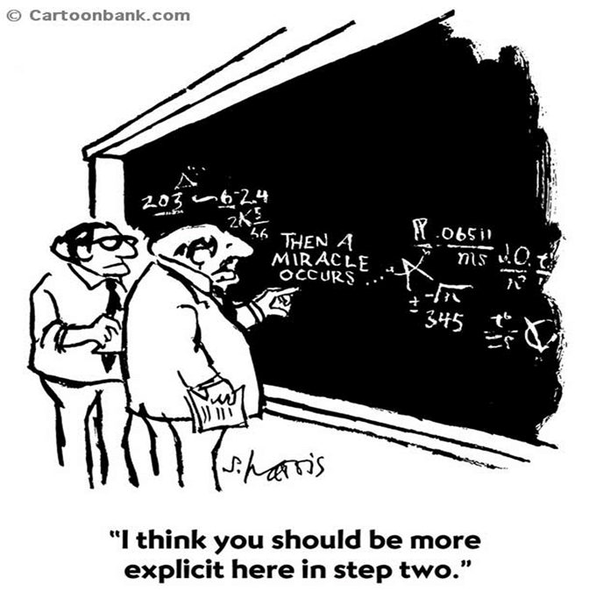
What is learning?
Notes:
One of the most challenging endeavors in any scientific field is to understand how people learn.
When most people think about it in the context of an educational activity, what they think resembles what the graduate student wrote on the board.

Slide 5

What is learning?
An individual before an educational activity – current knowledge | Educational Activity Miracle? | An individual after an educational activity – enhanced knowledge
Notes:
If we replace the formulas on the right and the left with what an individual knows before and after an educational activity, I think you get the idea.
His professor wants to know more and I will try to take you on a journey this morning to unpack the “miracle” of how people learn.

Slide 6
What is learning?
There has been a debate for several years addressing the challenge of understanding how people learn. (Norman DA, 1993)
  Cognitivists – information processing/symbolic processing
  Social cognition – the role of the situation that an individual might find him or herself in (context, socio-cultural influences, etc.)
Caricatures
  Cognitivists focus entirely on the processing structures of the brain and the symbolic representations of knowledge.
  Situated cognition approach focuses entirely on the structures of the world and how they constrain and guide human behavior.

Slide 7
What is learning?
Scientific discussion
  New guys: justify claims for new approach by emphasizing flaws in the current discourse as well as the virtues and goodness of what they are proposing.
  Other scientists will justify the continuation of the current discourse by minimizing it current difficulties and discounting the powers or even the novelty of the newer approach.
This is good, it is how science advances our understandings through creative tension and dialectical progress.
Notes:
This is a classic scientific “discussion”.
The situated learning group developed an explanation of learning that essentially challenged what the cognitivists had been working on for years.
The new guys justified claims for their new approach by emphasizing flaws in the current discourse as well as the virtues and goodness of what they are proposing.
The cognitive scientists justified the continuation of the current discourse by minimizing its current difficulties and discounting the powers or even the novelty of the newer approach.
This is good, it is how science advances our understandings through creative tension and dialectical progress.

Slide 8
The new conversations about learning (Marchese, 1997)
In making choices about what to teach and how to assess it, we must communicate what we want students to learn.
What we teach must be authentic; it cannot be abstracted from the venues where our students will want to use what they have learned.
Deep learning is important for students to be able to transfer what they have learned to where they want to use what they have learned.
Flow is a mental state in which a person performing an activity is fully immersed in a feeling of energized focus, full engagement, and enjoyment in the process of the activity.

Slide 9
The new conversations about learning (Marchese, 1997)
What was your most rewarding learning experience?
Can you describe the experience in terms of
    Communication
    Authenticity
    Deep learning
    Flow
Notes:
I am not going to ask you to take a stand in this debate.
But as preparation for what I want to talk to you about, I would like you to reflect and think about the most rewarding learning experience that you have had. Use Marchese’s principles to help you reflect. I am not going to ask you to share.
90 seconds…
How many of you identified a classroom setting as where your most rewarding experience took place?
Clinical setting?
Online?
Other?

Slide 10
What is Learning?
“… a change in the learner’s knowledge attributable to experience” Mayer (2010) Med Educ
“… a process that leads to change, which occurs as a result of experience and increases the potential for improved performance and future learning” Ambrose et al (2010) How Learning Works
“…acquiring knowledge and skills and having them readily available from memory so you can make sense of future problems and opportunities” Brown et al (2014) Make it Stick
“… any process that allows a person to extract insights from experience, insights that are useful in solving problems in the future” Slotnik (1996) Acad Med
Notes:
Let’s look at some definitions of learning from several scholars…
Read slide…

Slide 11
What is Learning?
“… a change in the learner’s knowledge attributable to experience” Mayer (2010) Med Educ
“… a process that leads to change, which occurs as a result of experience and increases the potential for improved performance and future learning” Ambrose et al (2010) How Learning Works
“…acquiring knowledge and skills and having them readily available from memory so you can make sense of future problems and opportunities” Brown et al (2014) Make it Stick
“… any process that allows a person to extract insights from experience, insights that are useful in solving problems in the future” Slotnik (1996) Acad Med
Notes:
Here are some of what I think are the key words in these definitions.

Slide 12
What is Learning?
Process in which an individual and/or team has an experience that results in a change in the knowledge, skills, attitudes, or performance of the individual and/or team.
Notes:
And this is how I put those key words together into a definition.
You may want to compare this definition with your most rewarding learning experience, but I would like you to keep it in mind as we investigate learning in greater detail.

Slide 13
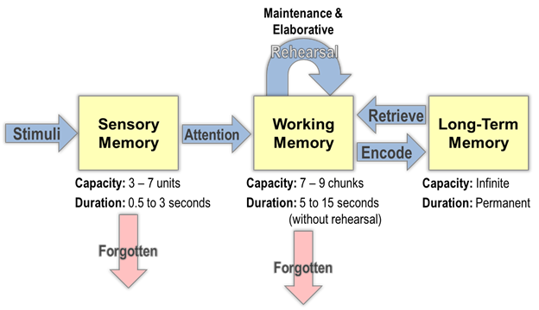
Information processing theory of learning
Notes:
Here is a graphic that represents the cognitivist view of how learning takes place information and symbolic processing.
It is more detailed than we will need for our purposes this morning.
Let’s look at a simpler graphic.

Slide 14
How does learning happen?
Environment |  | Sensory Memory |  | Working Memory |  | Long-term Memory
Sensing | Selecting words and images |  | Organizing words and images into categories |  | Matching categories with patterns |  | Prior Knowledge
Notes:
Components of the work that the brain does are portrayed in the top row.
And what those components do is displayed on the bottom row.

Slide 15
How does learning happen?
Environment |  | Sensory Memory |  | Working Memory |  | Long-term Memory
Sensing | Selecting words and images |  | Organizing words and images into categories |  | Integrating: matching categories with patterns |  | Prior Knowledge
Experience
Paying attention to relevant elements in the environment.
Constructing connections among incoming elements.
Constructing connections among representations and prior knowledge.
Considerable interaction between working memory and long-term memory.
Encoded as patterns in long-term memory.
A learner will use selecting, organizing, and integrating processes on stimuli sensed in the environment to construct new knowledge in working memory.
Notes:
If you are a cognitive scientist, this may be over-simplification, but I think it provides a reasonable general picture of what is going on in the information processing perspective for the rest of us.
Read the slide…

Slide 16
How does learning happen?
Environment |  | Sensory Memory |  | Working Memory |  | Long-term Memory
Sensing | Selecting words and images |  | Organizing words and images into categories |  | Matching categories with patterns |  | Prior Knowledge
Perceptual Learning (Kellman P, 2013; Krasne S, 2013):
Process by which the ability of sensory systems to respond to stimuli is improved through experience.
Experienced clinicians largely function using pattern recognition and thought processes that are faster and more accurate than novices.
Learning involves domain-specific changes in the way the brain extracts relevant information from the learner’s environment.
Discovery: finding information relevant to important classifications (categories).
Fluency: efficiency in extracting and encoding relevant information.
Notes:
Perceptual learning is increasingly being considered important because it operates at the interface of the individual and his or her environment.
Studies in this area may provide important clues that will move the debate that I mentioned forward.
Read the slide…
I think item #3 is very important.

Slide 17
Another perspective – Situated Learning (1)
A considerable amount of the conversation about learning in medicine has been cognitively oriented and draws on information-processing theories.
In information processing theories, knowledge is perceived to be a substance that is transferred from a teacher to a learner and becomes stored in the learner’s memory for later use.
Since the late 1980s, an alternative approach to understanding how learning occurs, situated cognition and associated theories, has gained increasing acceptance and more recently in medicine.
(Durning, 2011, 2013)

Slide 18
Another perspective – Situated Learning (2)
These newer theories
  reject the file-cabinet metaphor for knowledge that characterizes information processing theories
  for the more dynamic notion of “knowing” and places “knowing” in the larger physical, social, and cultural context where learning takes place.
The situated theories shift the focus from the brain of an individual to the settings within which human activity occurs.
The settings consist of activities (processes), individuals, artifacts, and sociocultural influences which are in continuous dynamic interaction.

Slide 19
Another perspective – Situated Learning (3)
Three venues for learning
  Formal
    Institutionally sponsored
    Classroom-based
    Highly structured
  Informal
    May occur in institutions
    Not typically classroom-based
    Control of learning rests primarily with learners
  Incidental
    By-product of some other activity
    Learning that takes place without any intent to learn
    Individuals not always aware that they have learned
  , 2001
Information-processing theories seem to characterize the teaching and learning that characterize formal learning venues.
Learners are required to take what they learn in formal venues and use it in practice settings where they must adapt it to the contextual features that characterize the setting.
  Activities (processes)
  Individuals
  Artifacts
  Sociocultural influences
Marsick and Watkins, 2001

Slide 20

Another perspective – Situated Learning (3)
Three venues for learning
  Formal
    Institutionally sponsored
    Classroom-based
    Highly structured
  Informal
    May occur in institutions
    Not typically classroom-based
    Control of learning rests primarily with learners
  Incidental
    By-product of some other activity
    Learning that takes place without any intent to learn
    Individuals not always aware that they have learned
  , 2001
On the other hand, situated learning theories seem to characterize incidental learning venues and to some extent informal learning venues.
Situated learning theories typically describe how a health care practitioner learns embedded in a clinical setting.
How do situated learning theories describe how learning takes place?

Slide 21
Another perspective – Situated Learning (4)
Billett, 2009
Notes:
Here is a picture of learning from the perspective of situated cognition created by Stephen Billett, one of the leaders in the field of workplace learning, which has accepted the notion of situated learning.
The individual is on the right side of the slide and the situation he is engaged in is on the left side of the slide.
Next slide…

Slide 22
Another perspective – Situated Learning (5)
Knowing and learning are relationships between an individual and the situations that he or she is in.
  Activities (processes)
  Individuals
  Artifacts
  Sociocultural influences
Another definition of what learning is:
  Knowing is the ability to interact with other people and things in a situation.
  Learning is an improvement in that ability – getting better at participating in a situated activity.
Greeno, 1993

Slide 23
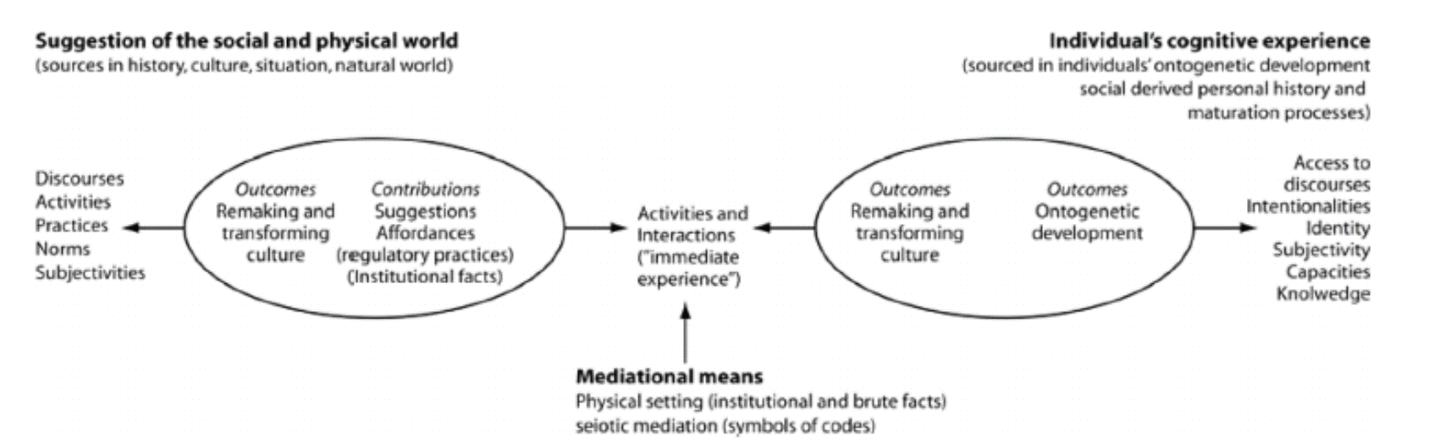
Another perspective – Situated Learning (6)
Billett, 2009
Notes:
What constitutes a learning experience?
When an individual encounters an event, she selectively perceives elements of the physical and socio-cultural environment in which the event occurs. (Kellman and Goldstone)
She selectively perceives certain elements because she has learned that those elements are important as a result of ongoing engagements with similar events.
What she has learned about these elements shape how she will perceive the event and what new learnings he will construct.

Slide 24

Another perspective – Situated Learning (6)
Notes:
What she perceives projects an opportunity for learning.
Learning involves a negotiation between the opportunities that the socio-cultural and physical world projects and his perception of that projection.
Moderating factors may be her developmental level as well as her level of energy, state of fatigue, and/or emotional condition.
It is through these negotiations that individuals change and norms and practices are changed.

Slide 25

Another perspective – Situated Learning (6)
Notes:
The institutional setting as well as her physical and emotional condition will mediate her ability to engage with her practice in its environment.

Slide 26
Another perspective – Situated Learning (6)
Billett, 2009
Notes:
Another way to describe how learning occurs.
Learning occurs when an individual engages with her surroundings and uses what she knows, can do, and values to expand what she knows, can do, and values.
What an individual knows, can do, and values shapes the scope of her learning potential.
Her potential can be described as the difference between what she knows now and what she needs to know to perform effectively in her practice domain, what we sometimes call a “professional practice gap”.

Slide 27
Another perspective – Situated Learning (6)
Billett, 2009
Notes:
Her practice exists in a socio-cultural and physical environment.
As she engages with that environment, it projects clues and cues that she picks up that enable her
to understand what she needs to know,
what she needs to do
and what she needs to value to be successful.

Slide 28
Another perspective – Situated Learning (6)
The amount of information available to the senses is enormous.
By the time a clinician has collected information about the “world” he practices in, it has changed.
The rapid pace of change is creating an ever-expanding gap between what clinicians know, can do, and value at one moment and what they need to know, do, and value at the next moment in order to continuously provide optimal care.

Slide 29
Another perspective – Situated Learning (6)

Slide 30
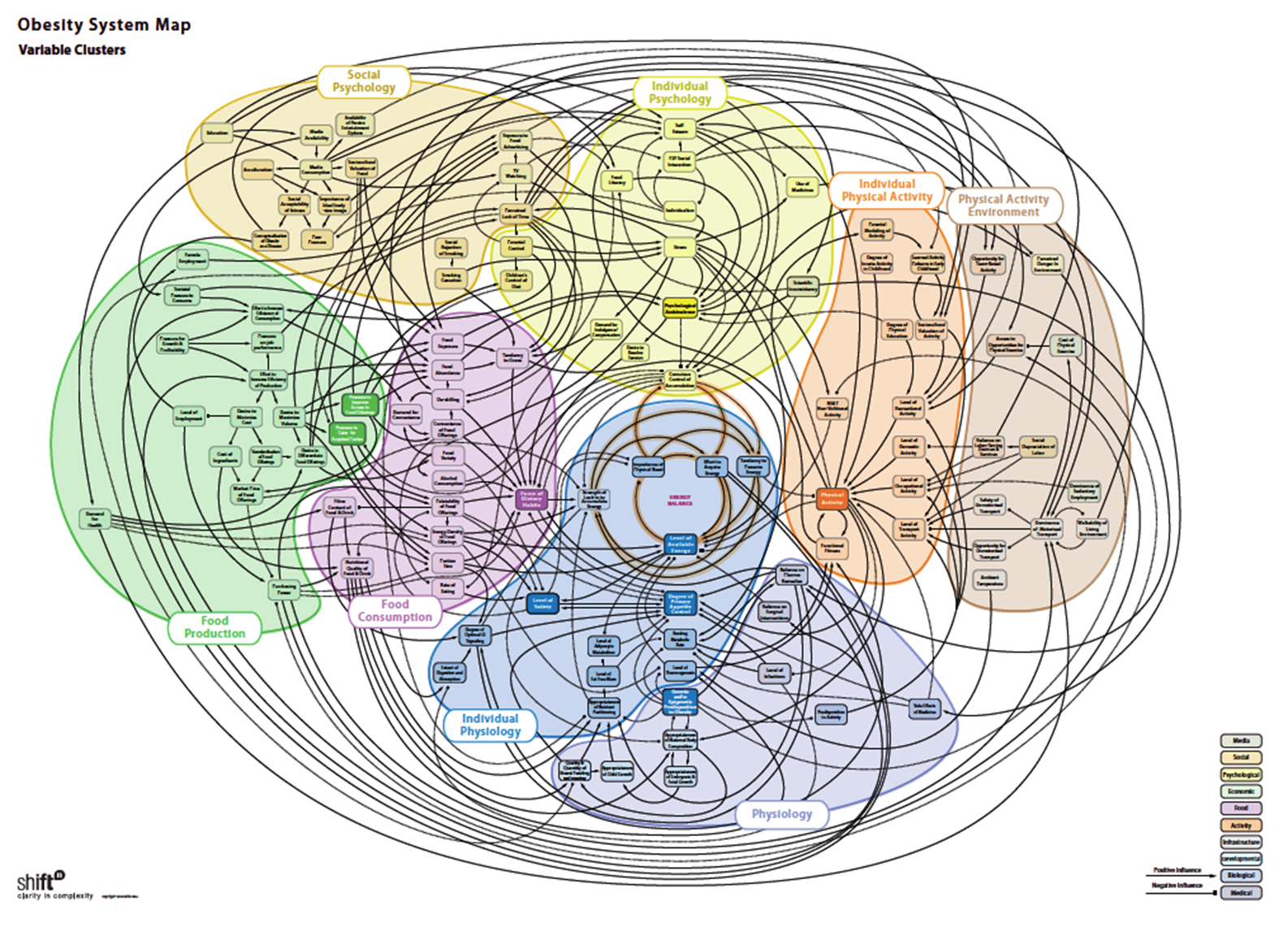
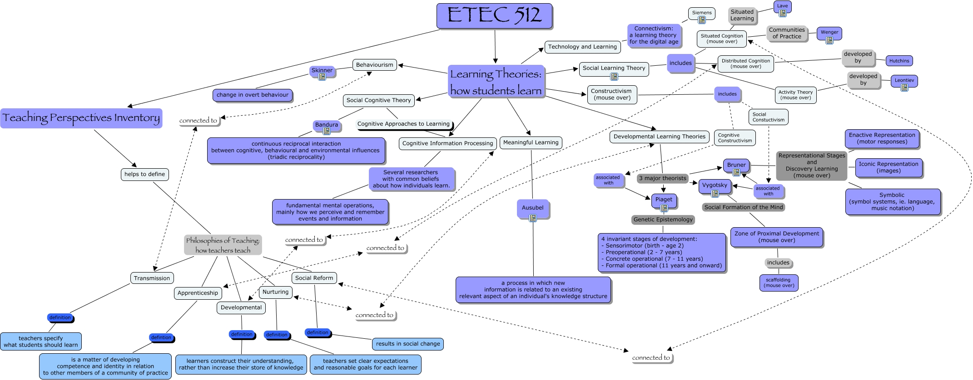
Learning in practice: Situated
Practice: Managing obese patients
Clinician

Slide 31
What is knowledge – knowing, doing, valuing
Declarative, procedural, and dispositional knowledge is required for successful work experiences.
Declarative– facts, concepts, and propositions which are the kinds of knowledge that people can state – they are declarative knowledge.
Procedural knowledge – what people use to achieve goals through thinking and acting.
Dispositional knowledge – comprises attitudes, values interests, and intentions that direct and guide an individual’s conscious thinking and acting, and therefore learning.
More comprehensive than and supersedes Bloom’s taxonomies.
Billett, 2015
Notes:
Billett has created an expanded definition of knowledge that will help us understand learning in the situated cognition perspective.
Read slide…

Slide 32
What’s going on in the practice setting?
At the same time that situated cognition theories were gaining increasing acceptance, “practice theory” was becoming increasingly important in the field of organizational studies.
  “Practice” is a commonly used term in the field of medicine – for example, the medicine practice on the sixth floor of the Doctors Building.
  In practice theory, however, “practice” is more the “practice of medicine” than the medicine practice on the sixth floor.
  The medicine practice on the sixth floor is the site where the practice of medicine occurs.
  In practice theory, “practice” is the term that represents a “shared way of doing things” that a group of individuals have reached consensus about.

Slide 33
What’s going on in the practice setting?
A practice consists of activities (processes), individuals, artifacts, and sociocultural influences which are in continuous dynamic interaction.
A practice of medicine consists of:
  Doctors, nurses, other health professionals and office staff.
  What they do to provide health care services to people who seek those services.
  The things they use to plan, coordinate, deliver, record and monitor the provision of those services.
  The socio-cultural influences that color patterns of work and interpersonal relations.

Slide 34
What’s going on in the practice setting?
The practice of medicine has four main elements.
Purpose: the activities of the practice of medicine are organized to accomplish the goal of providing the best possible healthcare services to patients.
Practical understanding: knowing what to do, how to do it, when to do it and why to do it.
Rules: explicit formulations, principles, precepts, and instructions that direct people to perform certain activities at certain times and in conjunction with other people.
General understandings: Collective system of dispositions that individuals or groups have that deeply internalized societal or field-specific presuppositions that “go without saying” and are not up for negotiation.
Within each practice, there is agency, the human capacity to act, that emerges from the complex interaction of these four elements and the individual.
Schatzki, 2002, 2012

Slide 35
What’s going on in the practice setting?
Practices of medicine are local professional complex adaptive systems.
They are dynamic bounded webs of diverse agents interacting non-linearly.
  Dynamic - Continual presence of multiple interactions and their accompanying surprises, challenges, and responses, both within the practice and between the practice and its environment – microsystem; mesosystem; macrosystem. (Godfrey, 2008)
  Bounded – defining purpose: delivering best possible health care services
  Web – multiple interconnections
  Agents – people who act in the system and have the capability to exchange information, learn, and adjust their behaviors – no one agent can understand and/or do everything that is happening in the practice
  Professional – application of socially defined professional values and professionally defined expertise to the health problems presented by patients
Miller, 2001, 1988

Slide 36
Knowing in practice
In practice theory, the term “knowledge” has been replaced by the term “knowing”.
“Knowing” signifies a process and like any process “knowing” can unfold over time.
The use of the term “knowing” has led to its use as an “activity” in practice theory studies.
Knowing in practice is always a combination of declarative, procedural, and dispositional knowing.

Slide 37
Learning in practice
Opportunities for learning in practice emerge from the contingently formed patterns of understandings and interactions when agents enact the practical and situated work activities with others, often using material resources in their environment. (Boud, 2010)
When learning in practice occurs, it emerges from a congruence of goals (providing the best possible health care services) providing an opportunity for an agent to activate participation through knowing.
Notes:
Contingent: dependent for existence, occurrence, character, etc., on something not yet certain; conditional

Slide 38
Learning in practice
In a clinical encounter, a clinician, who is one of the agents in the practice in which the encounter takes place, engages with the practice to perform the activity he is expected to perform.
The clinical encounter is an “activity” of the “practice”.
A relationship forms with a patient, who is also one of the agents in the practice in which the encounter takes place.
The clinician is expected to have “knowing” (the integration of what to do, how to do it, and values) to perform his role in accomplishing the goal of the practice (provide the very best possible health care services to people who seek them).
Notes:
Let me try out how I think learning occurs in practice. This example describes what I think might go on in a primary care practice.
But I think the principles can apply to any clinician’s practice.

Slide 39
Learning in practice
The clinician is participating (by knowing) in the practice as are the patient, the receptionist and the intake nurse.
There are artifacts in the practice that serve as extensions of the clinician’s knowing:
  The health record.
  The variety of instruments that the intake nurse or the clinician may use to acquire data from the patient.
  The paperwork provided by the receptionist and completed by the patient.

Slide 40
Learning in practice
As an activity in this practice, the clinical encounter has four main elements.
  Purpose: the clinical transaction is organized to accomplish the goal of providing the best possible healthcare services to patients.
  The agents in the clinical transaction have a practical understanding of what to do, how to do it, when to do it and why to do it.
  Rules: there are explicit formulations, principles, precepts, and instructions that direct agents to perform certain activities at certain times and in conjunction with other agents and artifacts.
  General understandings: There is a collective system of dispositions that the agents have that are deeply internalized societal or medicine presuppositions that “go without saying” and are not up for negotiation.
Notes:
You have seen these elements on an earlier slide.
Read slide…

Slide 41
Learning in practice
There are three possible learning outcomes for the clinician as the result of his activities and the relationships that were performed in this clinical encounter:
  His “knowing” was reproduced in the clinical encounter – what he knew, what he could do, and the values that guided his activities matched what the patient needed.
  His “knowing” had to be modified in the clinical encounter – what he knew, what he could do, and the values that guided his activities did not exactly match what the patient needed.
  He needed to create new “knowing” for the clinical encounter - what he knew, what he could do, and the values that guided his activities did not match what the patient needed.
Each of the agents involved in this activity of the practice would have three possible learning outcomes as well.

Slide 42
Learning in practice and expertise
In a complex adaptive system like the practice of medicine, clinicians must learn to navigate in situations where they are at the edge of their existing knowledge.
  Clinicians who can rely on their existing knowing or modify it in the clinical encounter are using “routine” expertise.
    “Knowing” was reproduced in the clinical encounter.
    “Knowing” had to be modified in the clinical encounter.
  Clinicians who recognize that a routine approach is not working and cannot rely on their existing knowing in a clinical encounter search for new knowing to address the challenge.
    New “knowing” needed to be created - what he knew, what he could do, and the values that guided his activities did not match what the patient needed.
Hatano and Inagaki, 1986

Slide 43
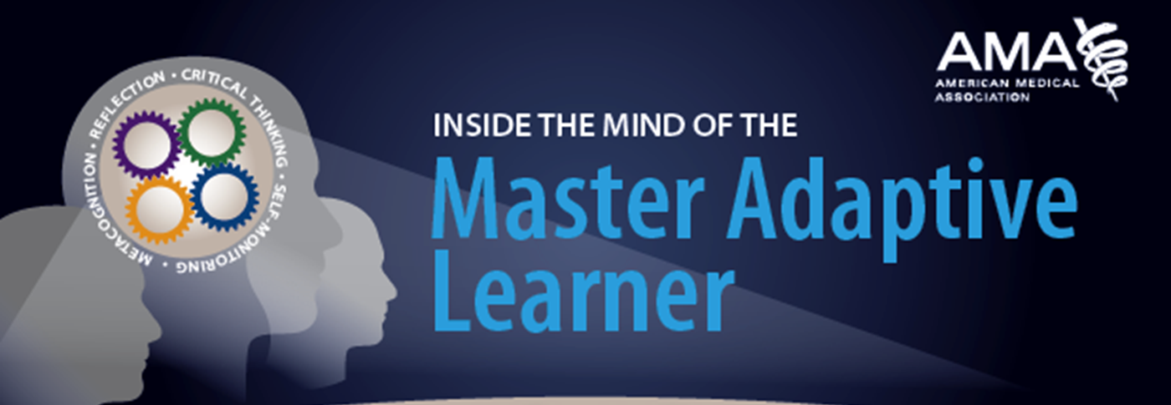
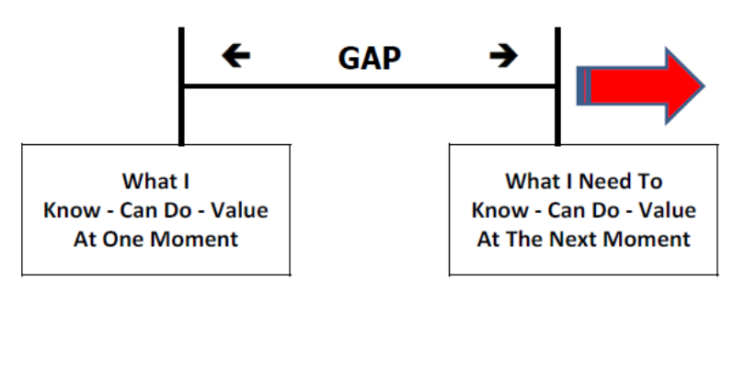
The Journey of a
Master Adaptive Learner
Practice
Novel Presentation
or
Unexpected Results
Critical Thinking
Identify assumptions
Analyze assumptions
Pursue alternative perspectives
Take informed action
Self-monitoring
Metacognition
Reflection-in-action
Reflection-on-action
Cognitive Dissonance
Mindful
Practice
Cutrer, 2016
Notes:
Remember in one of potential episodes of learning in the practice setting the clinician’s “knowing” did not work and she had to search for new “knowing”?
This is a schematic of that journey.
Explain slide.
Next slide has gears and coach

Slide 44

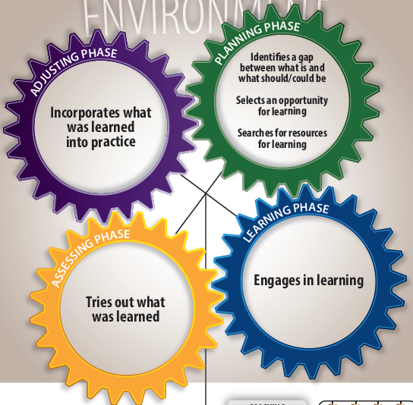
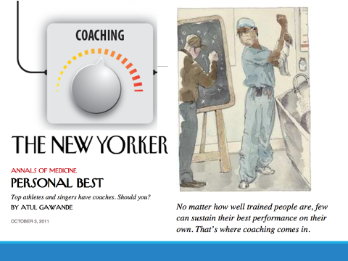

Slide 45
Prospects
This synthesis of theories and research from a variety of fields suggests that we are beginning to understand how clinicians (and other health professionals) learn in practice.
The image that emerges is one of active clinicians
  “knowing” what to do, how to do it and what values to follow.
  learning (improving their “knowing”) in three ways
    Reproducing their “knowing”
    Modifying their “knowing”
    Creating new “knowing”

Slide 46
Prospects
How can this emerging understanding be used to inform how opportunities for learning are provided to clinicians?
  Learning in the practice setting – incidental learning
  Self-directed learning – informal learning
  Classroom education – formal learning

Slide 47
Prospects
  Learning in the practice setting – incidental learning/routine expertise
  Learning = Clinician’s “knowing in practice” was reproduced or modified.
  Concerns – may capture the bulk of learning in a practitioner’s development
    The purpose of this form of learning in practice is improving efficiency, rather than on acquiring a deep understanding of one’s practice. As such, it might be considered a form of surface learning that limits a practitioner’s ability to make flexible use of the newly acquired knowledge in future practice settings. (Regehr, 2008)
    Because of the often un-reflective nature of this form of learning in practice, the resulting changes in practice might be described as a form of practice “drift” and may lead to inappropriate shortcuts and erroneous approaches to practice rather than to true evidence-based practice. (Regehr, 2008)
  Strengthen: Concurrent review of a clinician’s performance dashboard (Iliad)

Slide 48
Prospects
  Self-directed learning – informal learning/adaptive expertise
    Learning = Clinician’s “knowing in practice” was not working; new “knowing must be created to address the needs of patients.
    Concern: clinician may not know what he/she does not know or should know
      Self-directed learning process – problems with self-assessment
      Self-directed learning process – what is evidence?
      Self-directed learning process – self-regulating behavior?
    Strengthen: coach to help clinician (Hunt, 2016)
      Create and stick to plan
      Interpret performance dashboard
      Identify evidence-based resources

Slide 49
Prospects
Formal learning – institutionally sponsored/classroom-based
  Learning = declarative knowledge; additional learning required for clinician to use in practice.
  Concerns:
    Information processing model.
    What is learned may not be used in practice.
  Strengthen: inquiry-based learning: Star Legacy/Challenge Cycle (Klein, 2007)

Slide 50
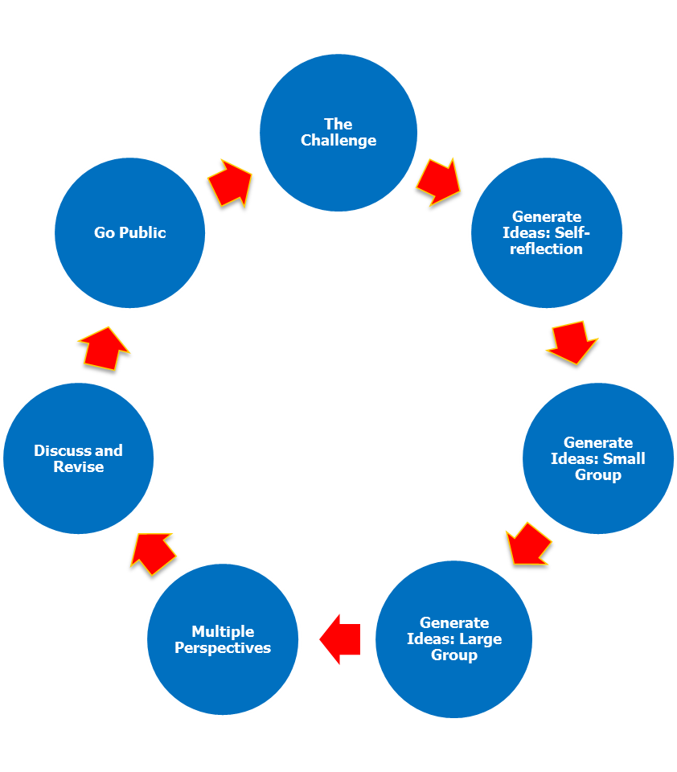
Prospects
How clinicians learn in practice.
The image that emerges is one of active clinicians
  “Knowing” what to do, how to do it and what values to follow.
  Learning (improving their “knowing”) in three ways
    Reproducing their “knowing”
    Modifying their “knowing”
    Creating new “knowing”

Slide 51
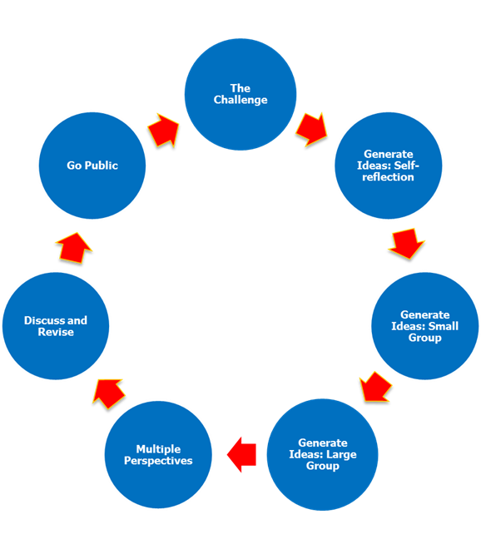
Prospects

Slide 52
Simulation
Simulation is increasingly being used in healthcare education to teach cognitive, psychomotor, and affective skills to individuals and teams.
It is important to first determine the desired outcomes of the curriculum to determine hoe best to use simulation.
Feedback is critical to effective learning using simulation, and should be guided by individual learning needs.
Simulation allows for training in a controlled environment, with opportunities for deliberate practice and assessment.
Simulation-based mastery learning, or SBML, significantly improves skills for all participants, and also leads to skill retention.
Motola, 2013

Slide 53
Adaptive Learning
Adaptive learning is an educational method which uses computers as interactive teaching devices, and to orchestrate the allocation of human and mediated resources according to the unique needs of each learner.
Adaptive learning technology changes the content, sequence or assessment that a student encounters in real-time, in response to the needs of the individual.
  Adaptive content
  Adaptive Assessment
  Adaptive sequencing

Slide 54
Adaptive learning
Adaptive Content
Technology with adaptive content focus responds to a learner's specific answer with content that provide corrective feedback and hints or learning resources.
Content
Assessment
Sequencing

Slide 55
Adaptive learning
Adaptive Assessment
Adaptive assessments change and respond based on whether learners answer questions correctly or incorrectly.
This change is often a result of the difficulty level of the question.
For example, if a student answers an easy question correctly, the next question the student gets will be a little harder and so on.
Content
Assessment
Sequencing

Slide 56
Adaptive learning
Adaptive Sequencing
Adaptive sequencing is the ability to continuously collect real-time data on a learner’s performance and use it to change his or her learning experience.
The technology continuously collects data and uses algorithms and predictive analytics to change what a learner sees next.
Data is collected on a student’s performance on an ongoing basis, the data is analyzed and used to adjust the overall sequence of skills or the type of content a learner sees next.
Content
Assessment
Sequencing

Slide 57
Adaptive learning
Examples of adaptive learning
A clinician responds to scenario about using a medication with Type 2 diabetes patient incorrectly and is offered supplemental materials and more practice problems on when and why that medication is used.
A clinician responds to a scenario about one component of a clinical practice guideline correctly the first time, so the program waits an interval of time and then re-quizzes the clinician to make sure that she is able to remember the information.
A clinician makes a mistake with a specific step of a clinical practice guideline about managing patients with rheumatoid arthritis, so he is provided with extra hints and supplemental practice problems on that step.

Slide 58
Perceptual and adaptive learning
Perceptual–procedural learning technology offers ways of bringing intuitive pattern recognition, interpretation of new cases, fluent processing, and procedural execution into the realm of systematic and objective instruction.
Adaptive learning technology improves learning by attuning the level, spacing, and sequencing of learning events to each individual learner, allowing more efficient learning, better retention, and certification of mastery.
Kellman P., 2013

Slide 59
Dilemmas
Current conceptualization of Continuing Professional Development (CPD)
Resources

Slide 60
Dilemma - Current conceptualization of CPD
Expectation: transfer of knowledge from formal educational activities. (Regehr, 2008)
Lack of success of current CPD (Cervero, 2015, Marinopoulos, 2007).
CPD “term” being used in place of “CME” term with no real changes.

Slide 61
Addressing the dilemma
Re-conceptualizing CPD to be practice-based (Boud, 2012) and more authentic (Wright, 2009)
CPD calls for clinicians to engage in (Campbell, 2010):
  A process of monitoring and reflecting on professional performance.
  Identifying opportunities to improve professional practice gaps.
  Engaging in both formal and informal learning activities
  Making changes in practice to reduce or eliminate gaps in performance.

Slide 62
Addressing the dilemma
Addressing Dilemma - Competency Domains for CPD
Domain | Key Competencies
Knowing one practice | Ability to use practice information to
 | Identify learning priorities
 | Develop and monitor CPD plans
Scanning the environment | Ability to access information sources for
 | Innovations in development
 | New evidence for potential integration into practice
Managing learning in practice | Ability to establish a personal knowledge management system to
 | Store and retrieve evidence
 | Select and manage learning projects
Raising and answering questions | Ability to
 | Construct a question
 | Search for evidence
 | Record and track conclusions for practice
Assessing and enhancing practice | Ability to
 | Use tools and processes to measure competence and performance
 | Develop action plans to enhance practice

Slide 63
Addressing the dilemma
Competence is the capacity of an individual to participate in the activities of practice, the ability to carry out actions in a given professional practice.
  Being a competent professional is being able to anticipate what is regarded as a good and favorable activity in a certain practice and to act accordingly.
  A highly competent individual is said to have a well-developed sense of what actions qualify as correct, suitable, approved.
  Competence is the inferred potential for desirable activity within a professional practice. Lindberg, 2015

Slide 64
Characteristics of
Continuously Learning Healthcare Systems
Science and Informatics
  Real-time access to knowledge
  Digital capture of the care experience
Patient-Clinician Partnerships
  Engaged and empowered patients
Incentives
  Incentives aligned for value
  Full transparency
Continuous Learning Culture
  Leadership-instilled culture of learning
  Supportive system competencies
US Institute of Medicine, 2013
Best Care at Lower Cost

Slide 65
Dilemma – Lack of resources
Resources
  Education can no longer be the short leg of the academic medicine stool – resources are needed to support a digital infrastructure that that integrates learning/knowing, researching/translating, and caring/implementing.
  A research program should be created with demonstration projects to determine what works for whom under what circumstances (Realist approach) and to demonstrate value.
  Mindsets - Need to change policy mindsets and proceed with theory-based policy to transform all phases of health professions education.

Slide 66
Learning objectives
  After participating in this session, you should be able to describe and discuss:
  The cognitive basis of predominant conceptions of learning.
  The role of situated learning theory and practice theory in creating a better understanding of how clinicians learn in practice.
  Prospects for using “how clinicians learn in practice” to create a more “authentic” continuing professional development.
  Dilemmas that stand in the way of achieving that future.

Slide 67
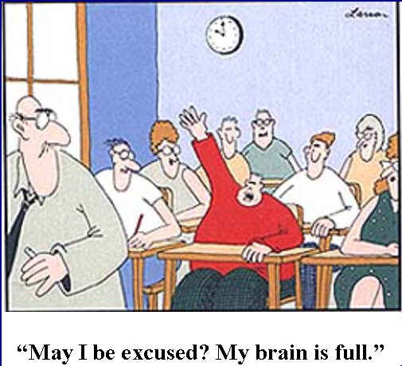
¿Puedo ser excusado? Mi cerebro está lleno!

Slide 68


Gracias! Thanks!
Notes:
Thanks for your attention.

